Slide 1
El Salvador Certification Program Overview
MINISTRY OF HEALTH
ITS/VIH PROGRAM UNIT
CLINICAL LABORATORY OFFICE
AUGUST 2024

Slide 2

TECHNICAL GUIDELINES FOR THE PERFORMANCE OF STI AND HIV TESTING IN CLINICAL LABORATORIES AND BLOOD BANKS
The Ministry of Health, as the lead agency, is responsible for issuing regulations and technical guidelines for the performance of STI and HIV tests in clinical laboratories and blood banks, in order to ensure that the results accurately reflect the patient's serological status.
The guidelines establish, through quality assurance, the standardization of facilities that perform rapid HIV tests, with measurement of quality indicators and the performance of standardized evaluations of all personnel who perform tests, with an evaluation of competence and satisfactory results.
Notes:
I. Introduction In accordance with the current Law and Regulations for the Prevention and Control of Infection caused by the Human Immunodeficiency Virus, which establish that the Ministry of Health, hereinafter referred to as MINSAL, is the governing entity in charge of issuing updated regulations and the necessary provisions to facilitate and achieve greater efficiency in the application of the Law and Regulations, as well as the development and application of the guidelines issued to countries at the international level by WHO/CDC. It is necessary to issue the present technical guidelines for the implementation of STI and HIV in clinical laboratories and blood banks, with the purpose of establishing the offer of services based on networks of clinical laboratories and blood banks, according to complexity to ensure that the results obtained in the analysis correspond to the serological status of the patient. The present guidelines establish, through quality assurance, the standardization of the establishments that perform rapid HIV tests, with measurement of quality indicators and the performance of standardized evaluations, in all the personnel that perform tests, counting on an evaluation of competence and satisfactory results, which is obtained through training, coaching and evaluations. It has been structured describing the main activities related to quality management applied to a diverse range of in vitro diagnostic and follow-up tests for STIs and HIV, establishing a mandatory compliance with the quality assurance cycle, whose components within the pre-analytical, analytical and post-analytical stages, as well as biosafety practices, constitute a guarantee of quality to be performed in clinical laboratories and blood banks in a precise, accurate, reliable and with technical-scientific excellence.

Slide 3

Objectives of the guidelines
General Objectives
Establish technical and administrative activities for the execution of tests for STIs and HIV, with quality assurance in the National Network of Clinical Laboratories and Blood Banks of the National Integrated Health System.
Specific
Define the technical and administrative processes for STI and HIV testing.
Strengthen the performance of clinical laboratories and blood banks in a context of quality assurance in STI and HIV testing.
Describe the functioning of the National Network of Clinical Laboratories and Blood Banks of the National Integrated Health System, for the performance of STI and HIV tests.
Establish the mechanisms to qualify for the quality assurance "Continuous Quality Improvement Initiative for the Use of Rapid HIV Tests (RTCQI)".
Scope of application The health personnel of the facilities of the National Integrated Health System are subject to the application and compliance of this document for the diagnosis of STIs and HIV. 9

Slide 4
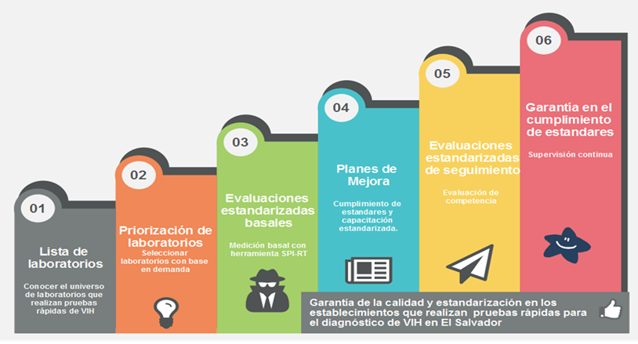
Scope of application
The application of these guidelines is subject to the application of these guidelines to the health personnel of the facilities of the National Integrated Health System for the diagnosis of STIs and HIV.
Due to the large number of laboratories or facilities that perform rapid tests for HIV diagnosis, the activities will be implemented in a staggered manner.
The first phase will address clinical laboratories that perform rapid tests from the network of services of the Integrated National Health System, in a prioritized manner with the following characteristics:
Health facilities with VICITS and VICITS-friendly clinics.
Health facilities with clinical laboratories with high demand for testing.
Health facilities with clinical laboratories with a high number of reactive results.
Health facilities located in geographic areas supported with PEPFAR, CDC, SE-COMISCA and UVG funds. Implementation of activities in the rest of the laboratories or sites of the National System.
Guarantee of compliance with standards
Improvement plans, compliance with standards, and standardized training
Standardized follow-up evaluations.
Standardized baseline evaluations: Baseline measurement using the SPI-RT tool
Select laboratories based on demand
Laboratory List
To know the universe of laboratories that perform rapid HIV tests
Source: STI and HIV testing initiative in clinical laboratories and blood banks.

Slide 5

SELECTION FOR REGISTRATION OF LABORATORIES IN THE RTCQII
VICITS and Amigables clinic laboratories in 100% of the 38 centers
Laboratories confirming with the diagnostic algorithm with rapid tests in 100 % (78), with the expectation of reaching 90 laboratories by 2024.
Notification sent by the Program Unit to the Directorates of the different Health Regions.
Preparation of baselines for registered laboratories, with their improvement projects.
Participation in the RCTQII workshop
Implement the tools learned
Follow-up measurements to measure level progress

Slide 6
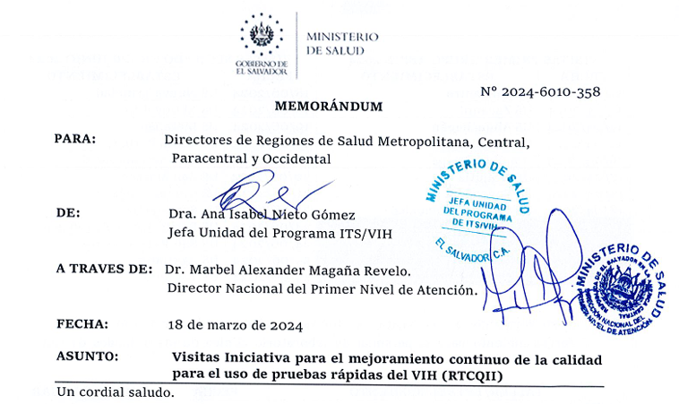
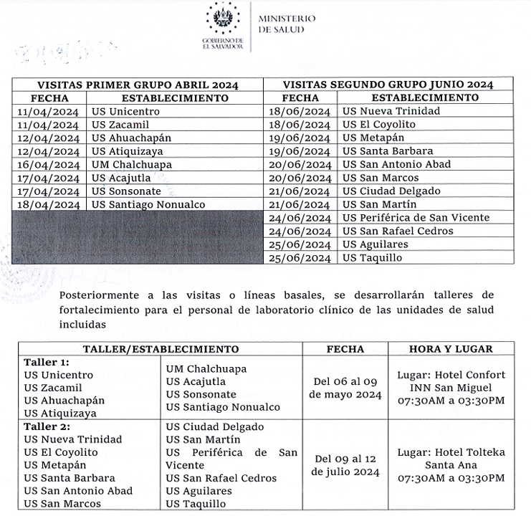
OFFICIAL NOTIFICATION OF ENTRY INTO THE PROCESS
Beginning of the process
Baseline visits
RTCQII Workshop
Follow-up visits

Slide 7
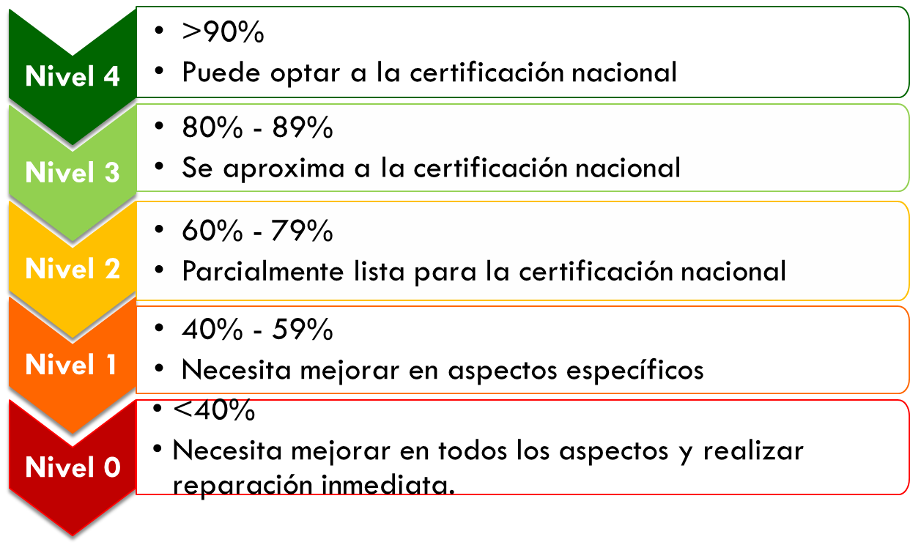
Levels of classification of laboratory preparation
Facilities are classified by levels to qualify for assurance of compliance with standards for laboratories that perform rapid tests for HIV diagnosis.
Source: Continuous quality improvement initiative for the use of HIV rapid tests.

Slide 8
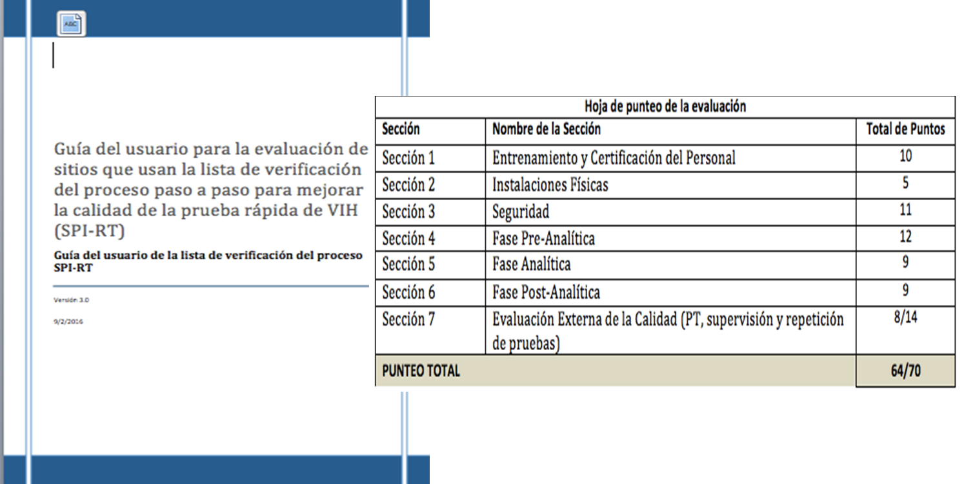
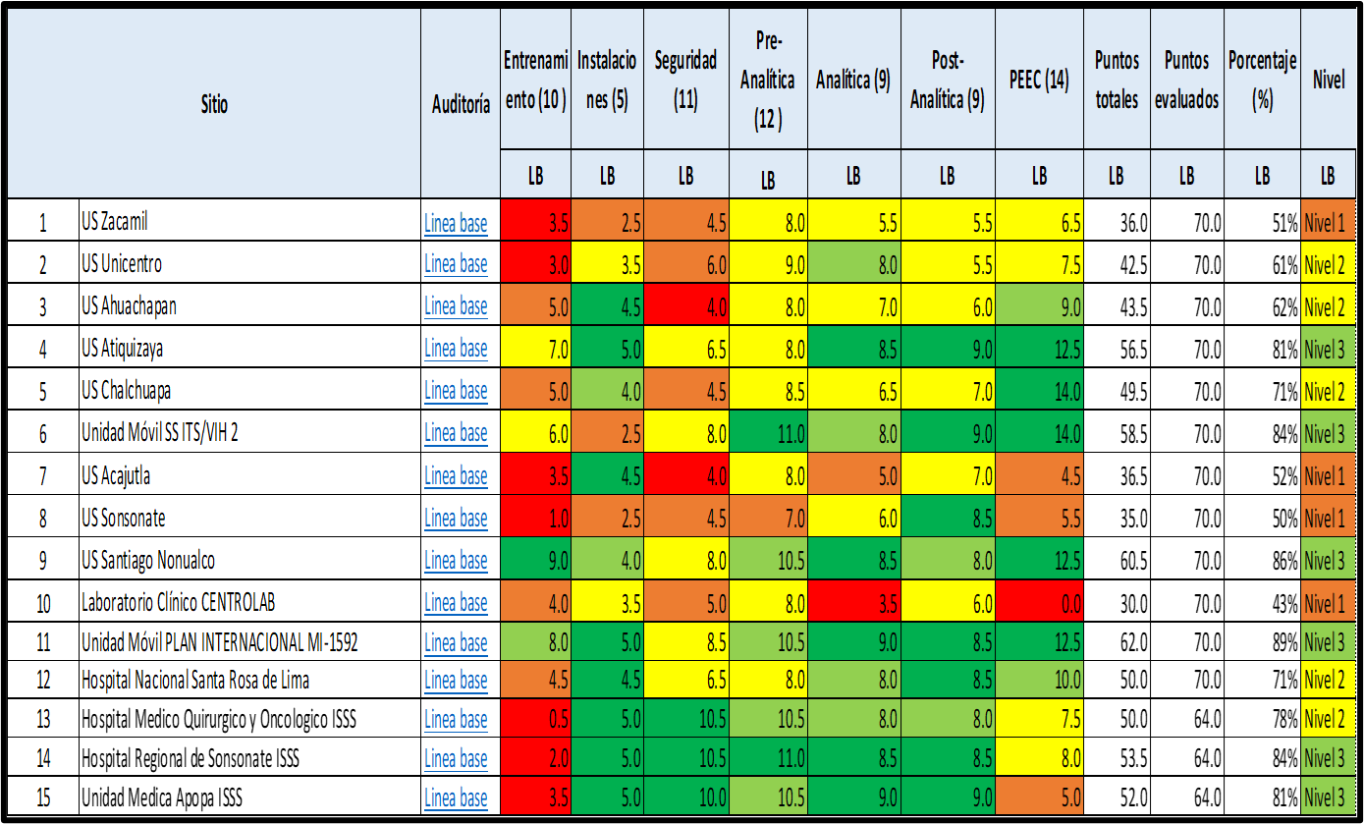
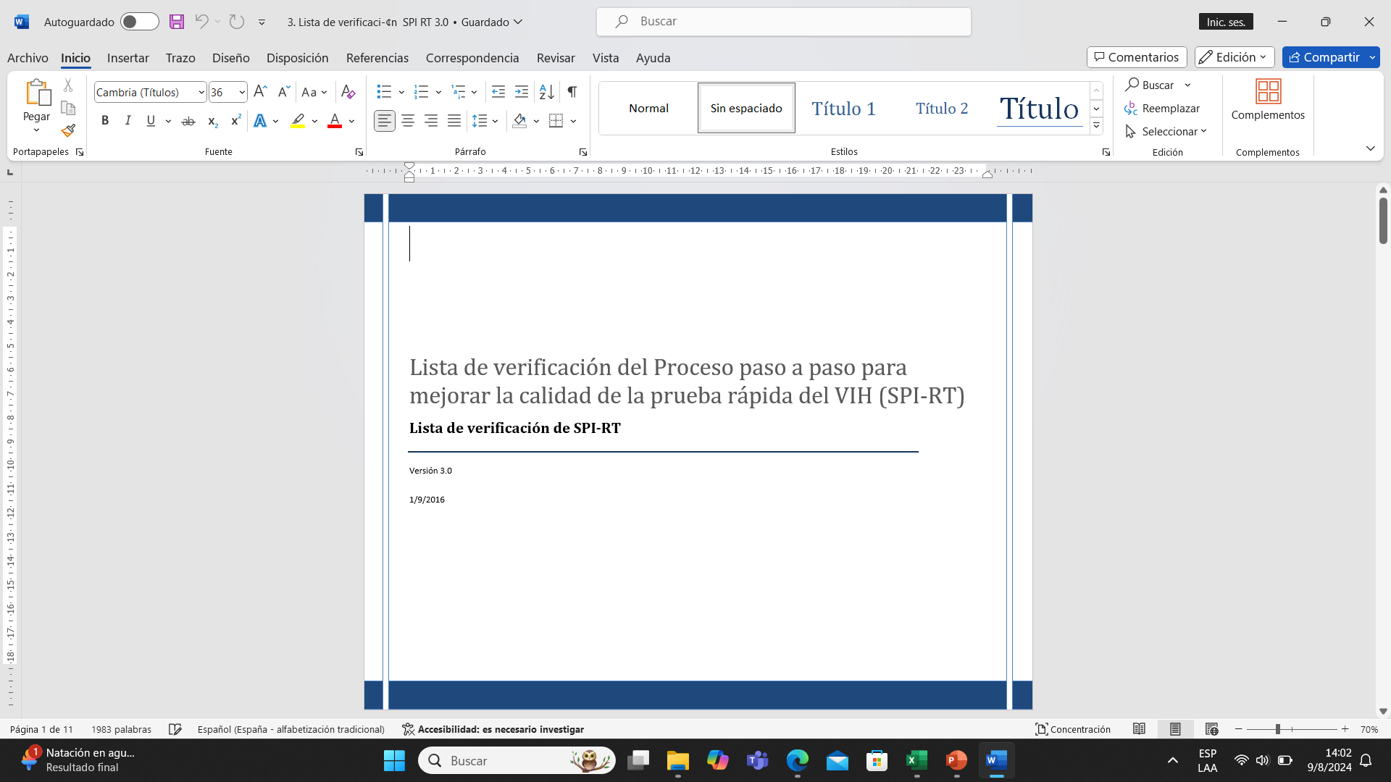
BASELINE VISITS RTCQII EL SALVADOR
Coaches pre-meeting
Trainer's Guide Update

Slide 9

Laboratory personnel
They must be qualified and competent personnel with training
Laboratory professionals performing the tests must be licensed and trained in the national training program or curriculum for personnel performing HIV testing.
Whenever a new method is introduced, training of all personnel involved is necessary.
In clinical laboratories, a competency measurement should be performed at least once a year (in those laboratories where there is more than one professional).

Slide 10

Human Resources Certification
Participation in the RCTQI workshop for training of trainers (Theoretical and practical)
Participation in the RCTQI workshop for testing personnel.
Theoretical-practical workshops using the RTCQI curriculum (Theoretical-practical workshop)

Slide 11
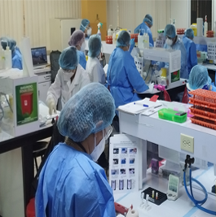

Training staff that perform tests
Training time (3 days) Delivered by personnel who have approved the trainer's plan.
The same topics should be included in each training to standardize the training.

Slide 12

Training program for personnel who perform HIV testing including assisted self-testing.
Sample collection and handling, with emphasis on samples used with the available tests.
Necessary documentation for the use of tests (Standard Operating Procedures, visual aids, registration forms, request, and report).
Theoretical: Diagnostic Strategies and Algorithms.
Testing procedures.
Reading and interpretation of results.
Result reporting.
Quality assurance, with an emphasis on internal controls and proficiency panels.
Biosafety.
Supply chain.
Training in addressing key populations, including the concepts of sexual orientation, sexual identity, gender expression, and identity.

Slide 13

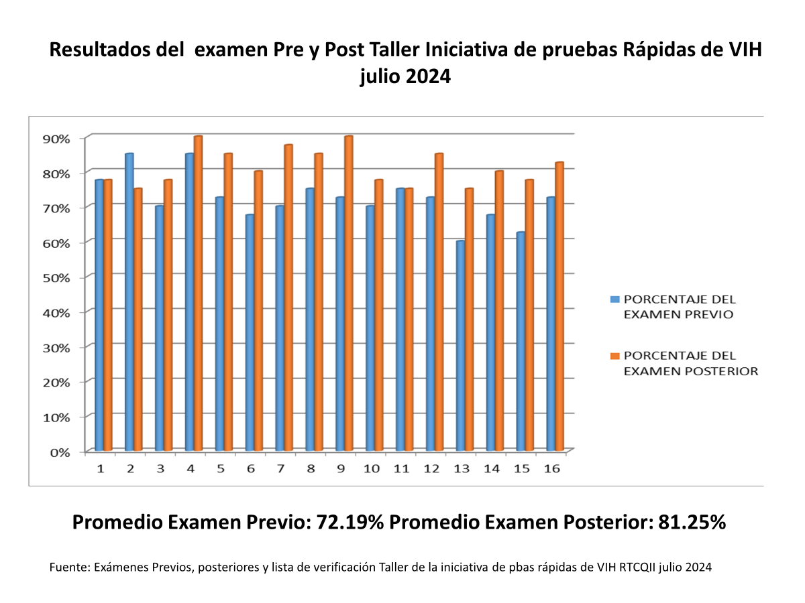
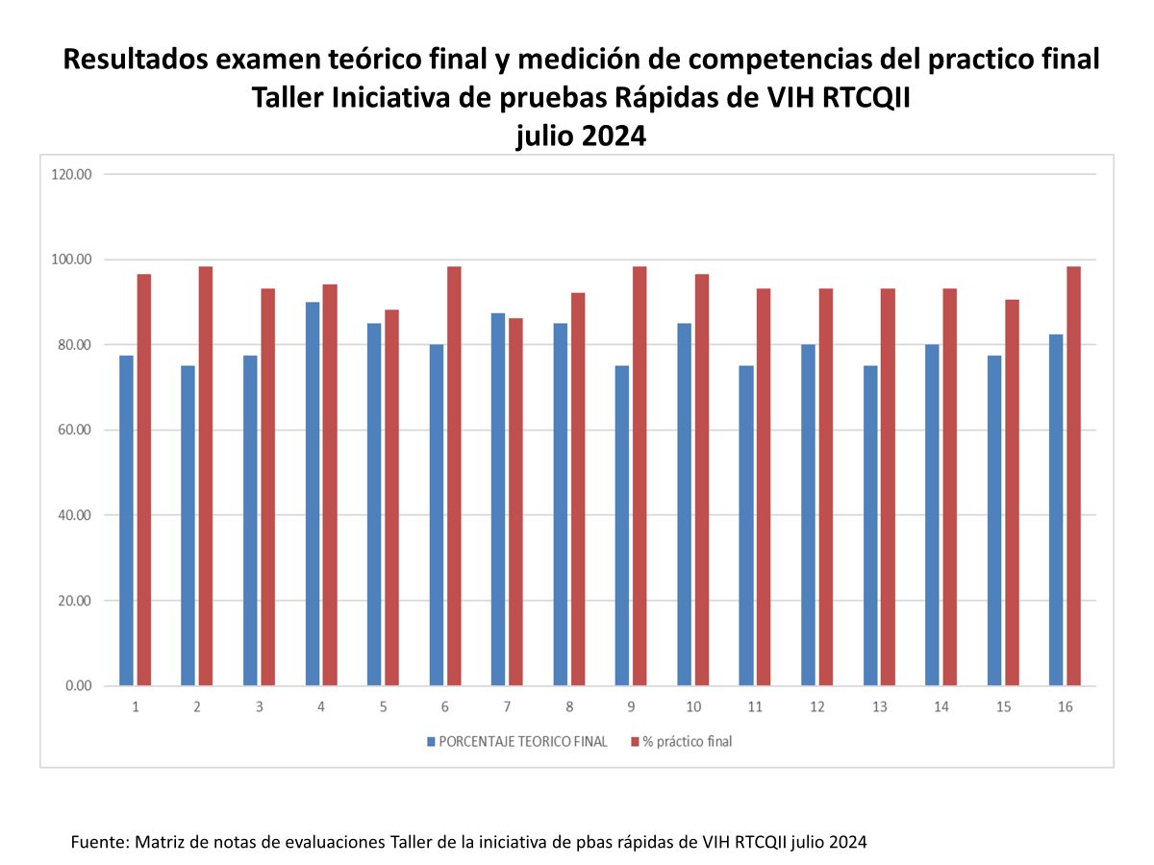
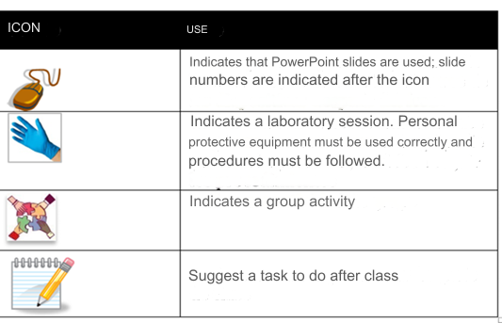
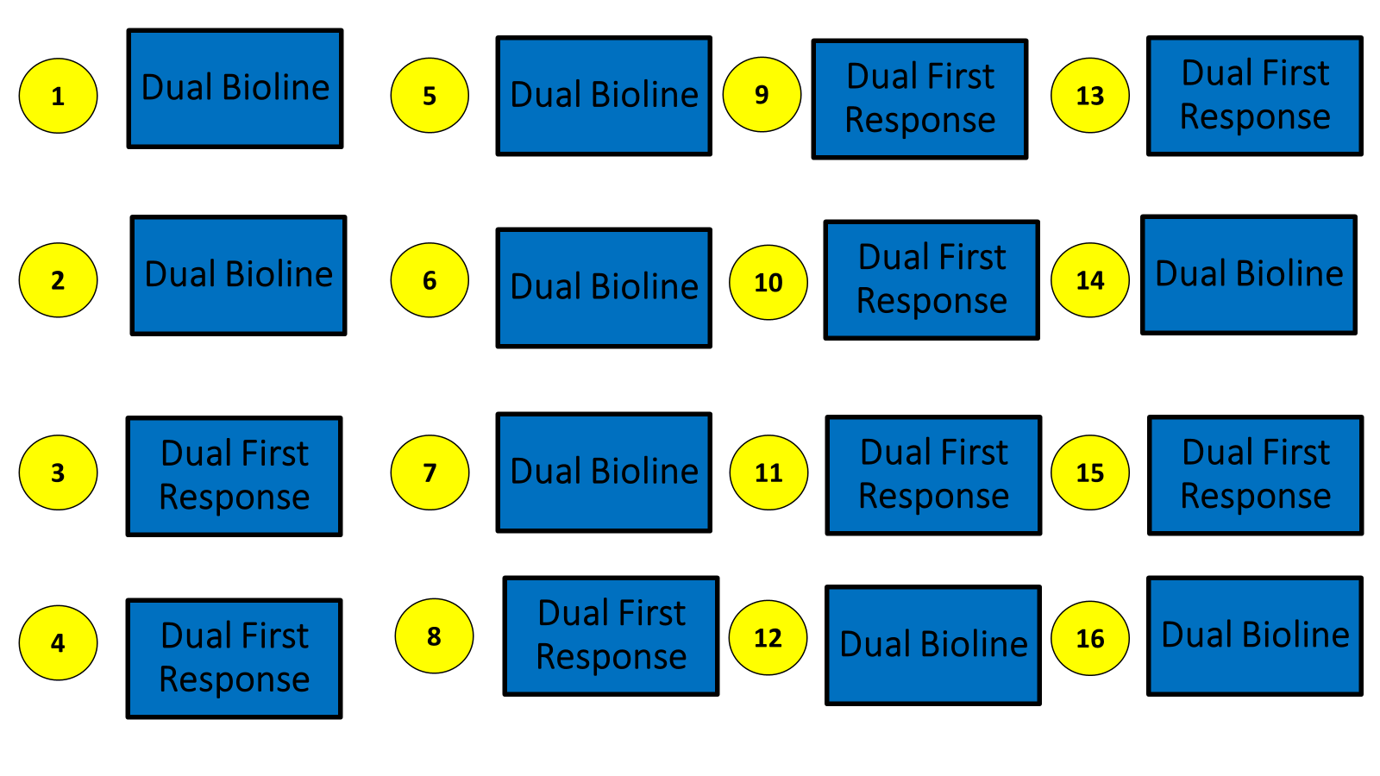
WORKSHOP RTCQII EL SALVADOR
1
2
3
Introduction to the Quality Assurance Cycle
Overview of HIV Rapid Tests
Safety at HIV Testing Sites
Results pre and post, workshop RTCQI july 2024
4
5
6
7
Toma de Muestra, Almacenamiento y Manejo
Sampling, Storage and Handling
Log Book
Introduction to Proficiency and/or Competency Testing - MST
Percentage previous exam
Percentage post exam
8
9
Professional Ethics
Test Site Visits
Mean score pre: 72.19%. Mean score post: 81.25%
Results final theoretical exam and competency evaluation RTCQI workshop

Slide 14



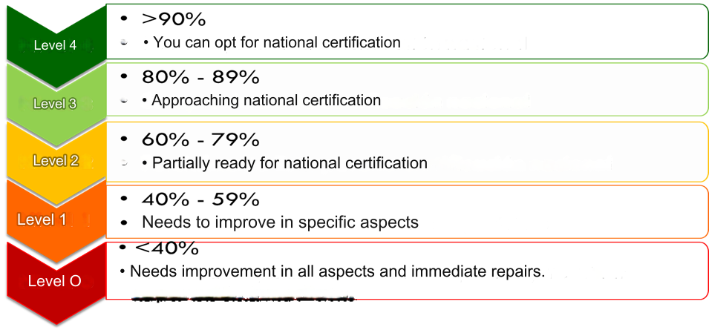
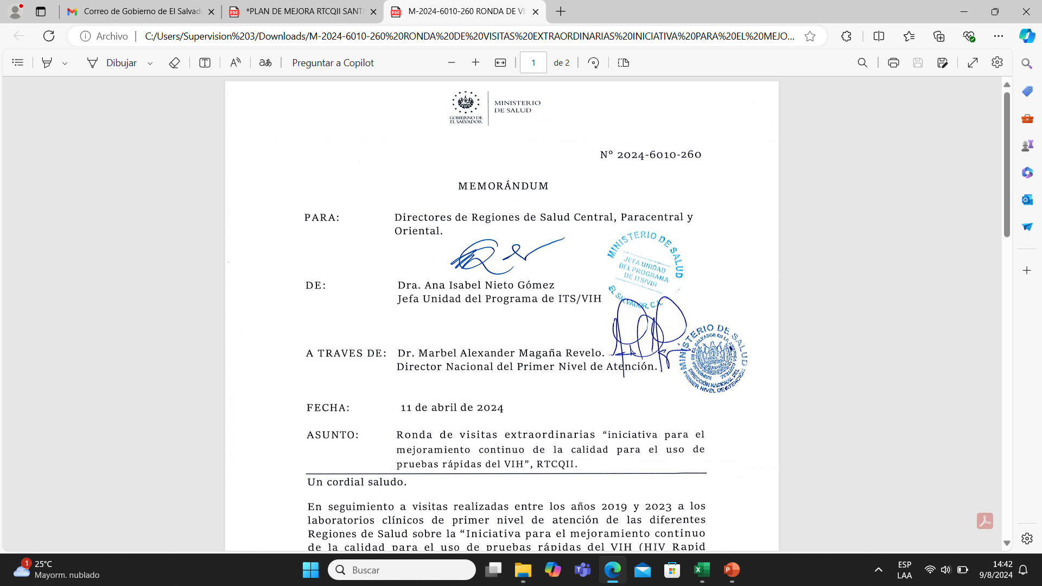
FOLLOW-UP VISITS RTCQII EL SALVADOR
What happens if the facility does not reach level 4?

Slide 15

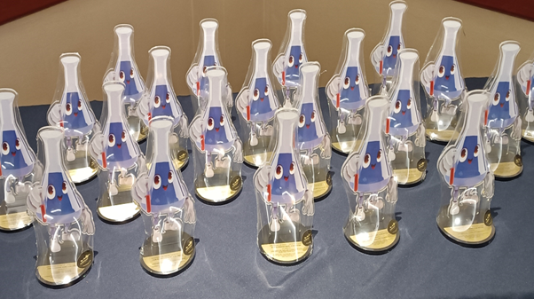
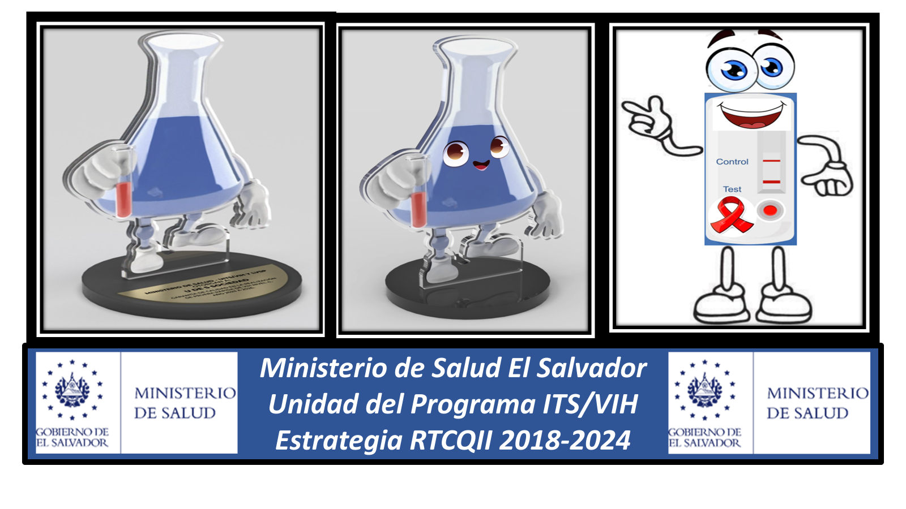
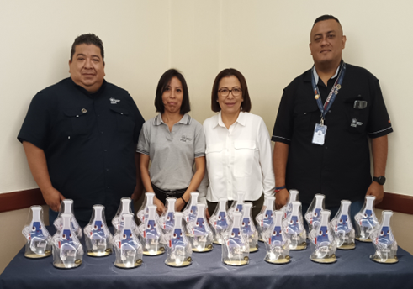
DELIVERY OF QUALITY GUARANTEES RTCQII EL SALVADOR
3-YEAR TERM/FOLLOW UP VISIT

